Slide 1
STUDENT ROOMMATE AND PG FINDER WITH COMPATIBILITY MATCHING
TEAM MEMBERS
JESBIN SHAJU
JESS JOHNSON
JEWEL THOMAS
K MUHAMMAD ANSAF

Slide 2
agenda
REAL WORLD SCENARIO 3
PROPOSED SOLUTION 4
SYSTEM ARCHITECTURE 5
IMAPCT AND COST EFFICIENCY 6
SDG MAPPING 7

Slide 3

REAL WORLD SCENARIO Students moving to a new city for higher education often struggle to find safe, affordable, and comfortable accommodation. They rely on informal sources like social media or word of mouth, which may not provide accurate or trustworthy information. Additionally, finding roommates with similar habits becomes difficult, leading to conflicts and inconvenience in daily life. The main issue lies in the absence of a centralized system that considers both accommodation availability and roommate compatibility. Students spend a significant amount of time searching for PGs and still end up with mismatched roommates or inconvenient locations, affecting their comfort and productivity.

Slide 4

PROPOSED SOLUTION
The proposed system is a web-based application that integrates PG listing and roommate matching into a single platform
It allows students to input their preferences and uses structured database queries to suggest suitable pg’s and compatible roommates, making the process more efficient and personalized.
It includes features like compatibility matching , rent splitting , preference recorder , contact , pg allocation etc ….
The system uses SQL queries to perform key operations. Compatibility between students is calculated based on their preferences using logical conditions.

Slide 5
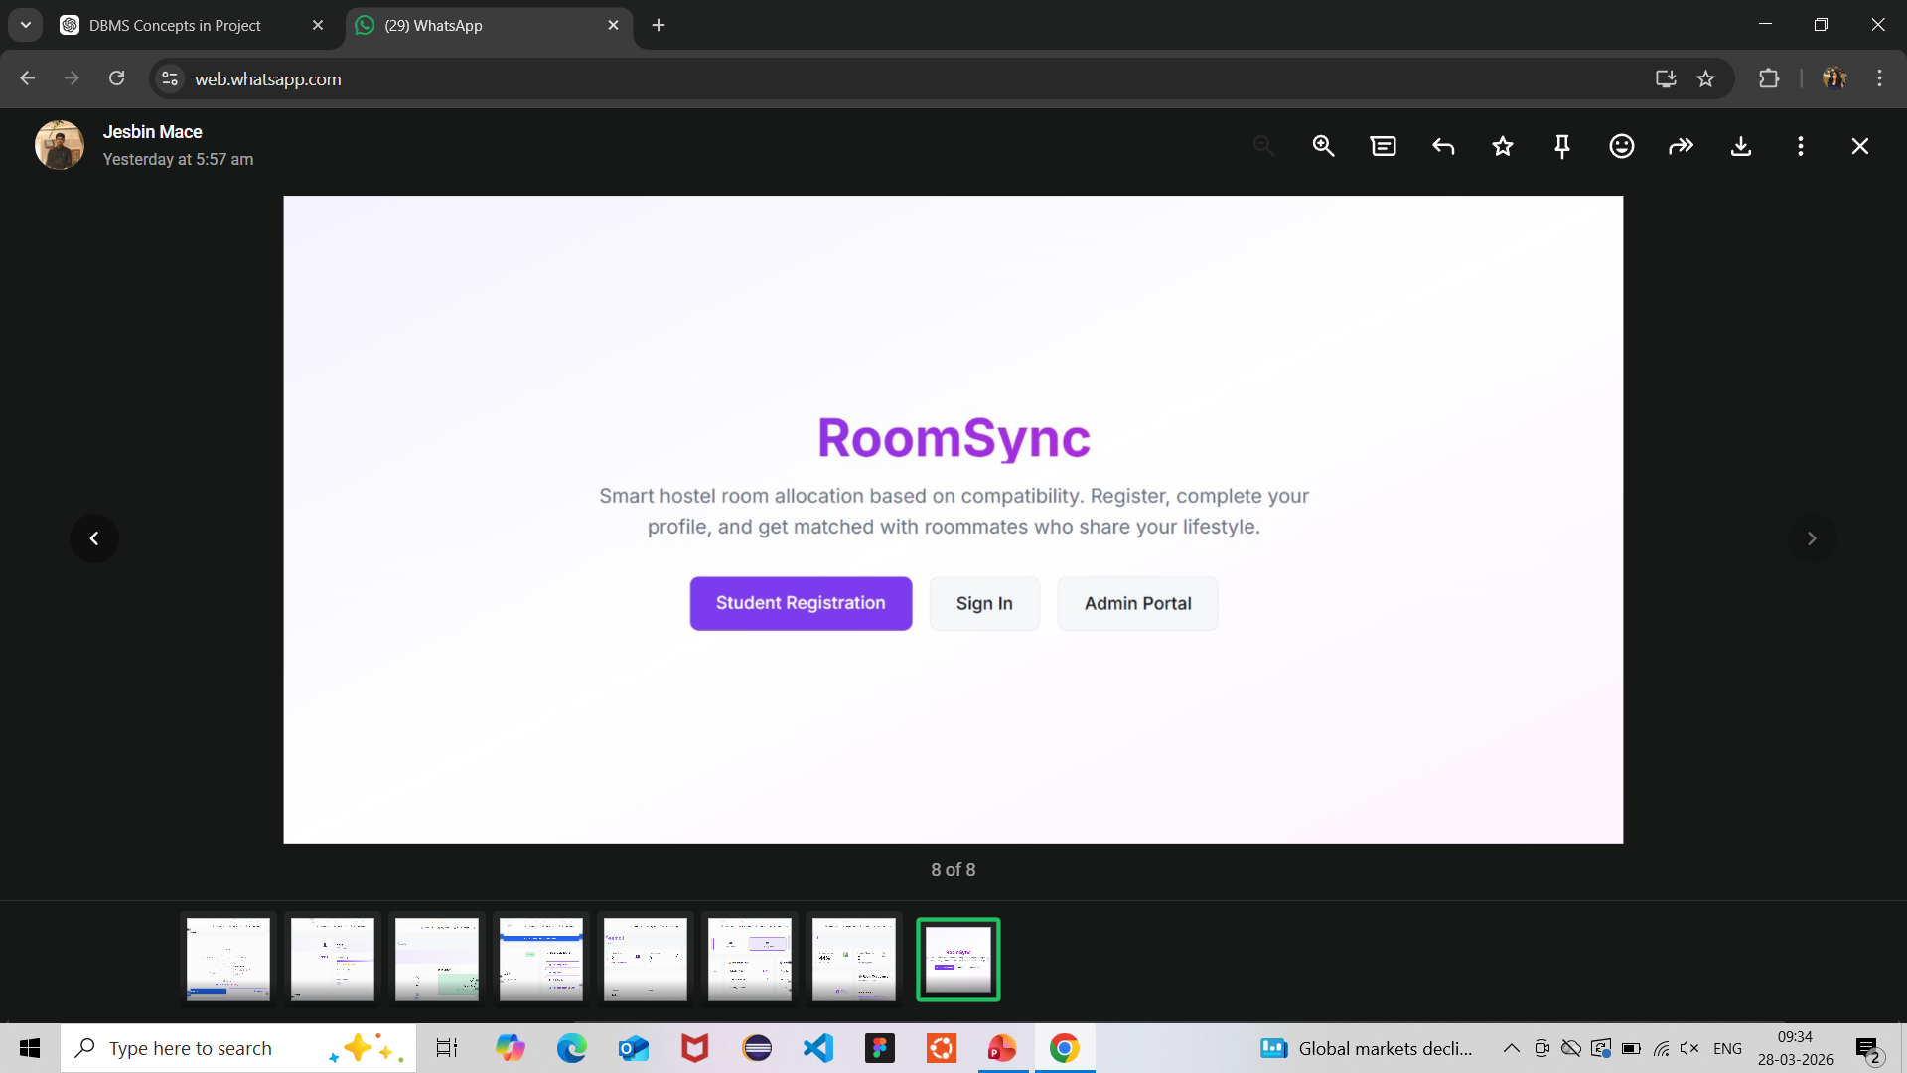
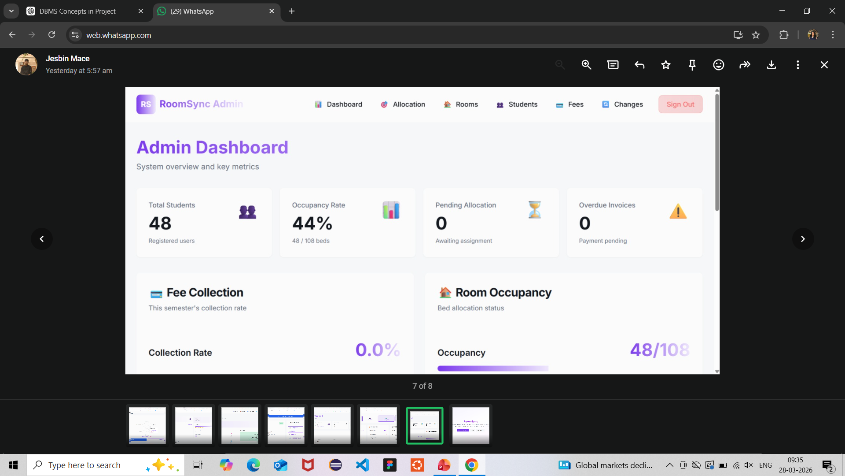
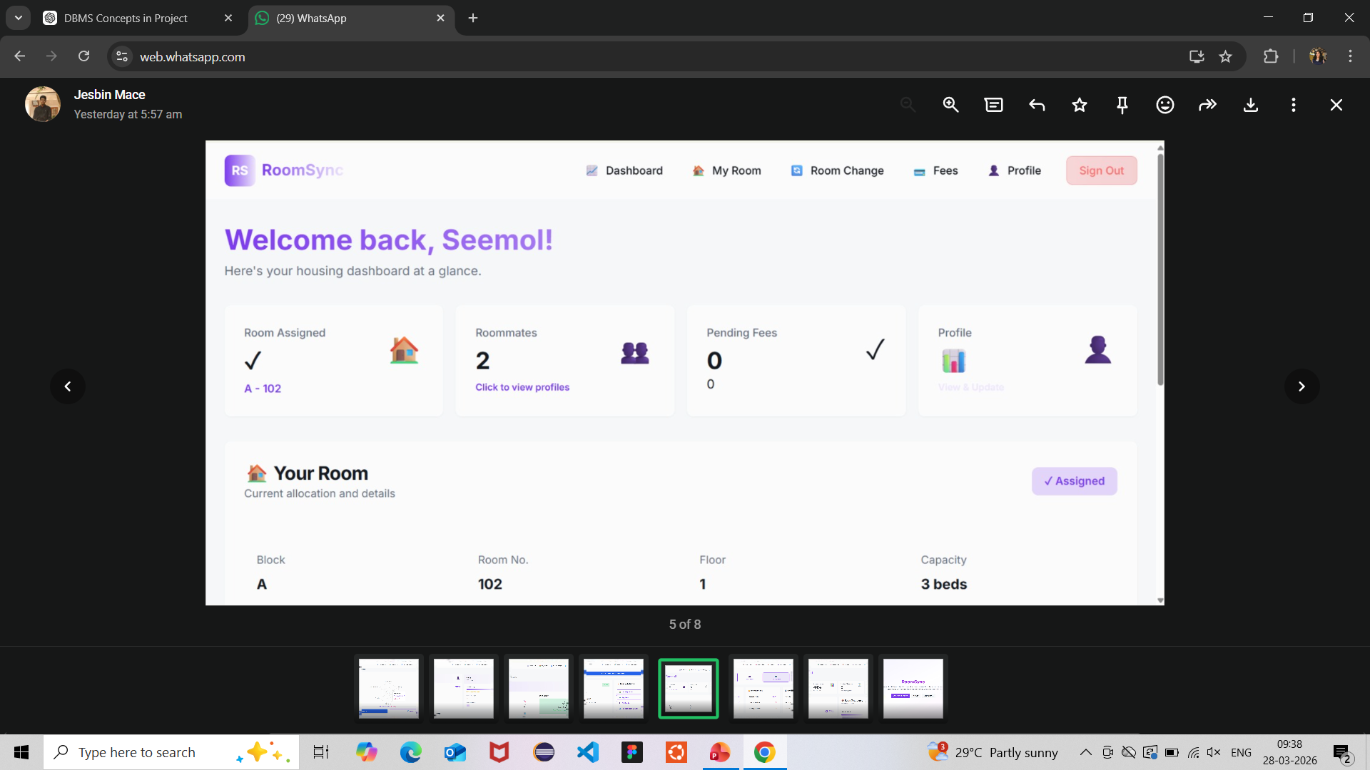
SYSTEM ARCHITECTURE
The system follows a three-tier architecture. The frontend is developed using TypeScript to provide an interactive and responsive user interface. The backend logic is managed through structured processing, and PostgreSQL is used as the database to store and manage all data efficiently.
The database is designed using a relational model with entities such as Student, Admin , PG Details, Bookingand Roommate Match. Relationships between these entities are maintained using primary and foreign keys to ensure data consistency and integrity
. The system uses SQL queries to perform key operations. Compatibility between students is calculated based on their preferences using logical conditions

Slide 6
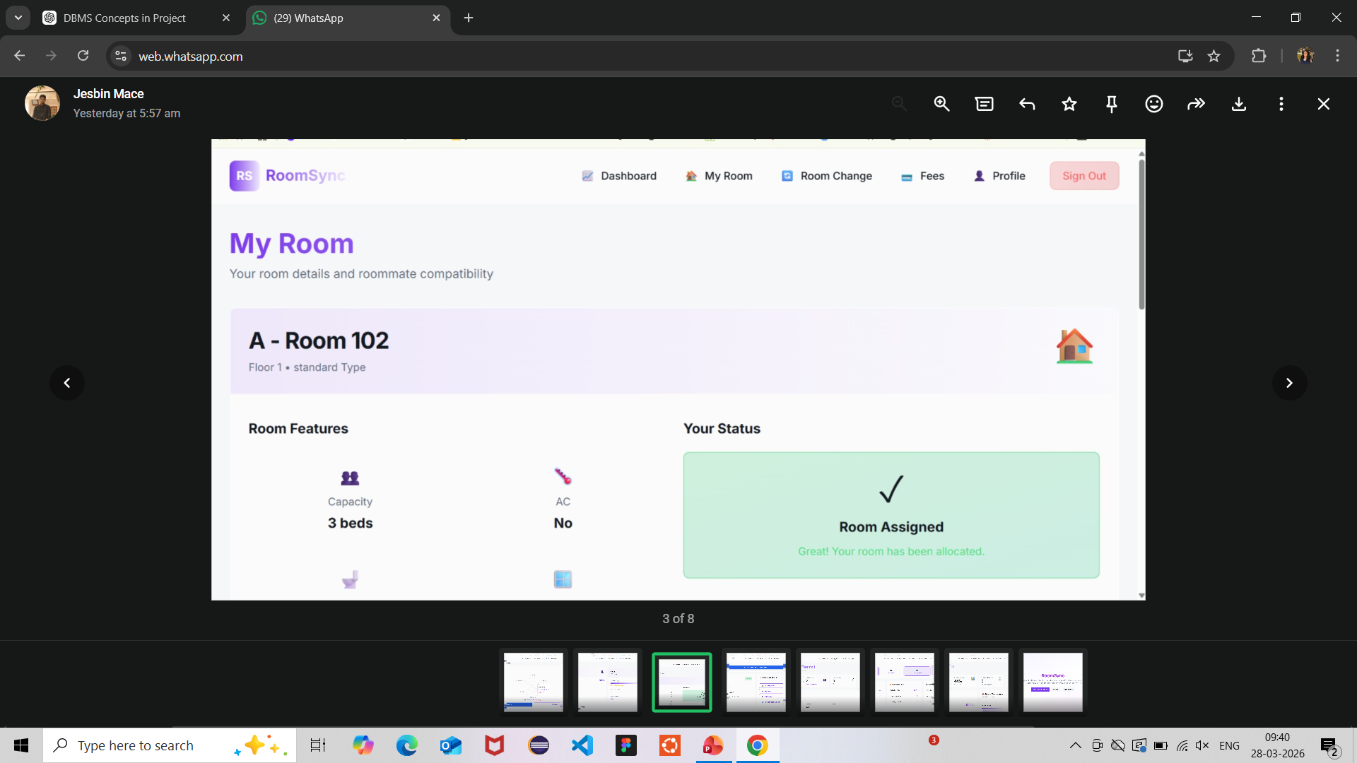
IMPACT AND COST EFFICIENCY
IMPACT
This system significantly reduces the effort required to find accommodation and improves decision-making for students. It also benefits landlords by providing a platform to reach potential tenants easily, thereby creating a more efficient housing ecosystem.
COST AND FEASIBILITY
The project uses open-source technologies such as TypeScript and PostgreSQL, making it cost-effective. It can be developed and deployed with minimal resources, making it highly feasible for academic and practical implementation.
The development process follows structured phases including requirement analysis, system design, database modeling, implementation, testing, and final deployment. This ensures a systematic and error-free development process.

Slide 7
SDG Mapping
SDG 4 – Quality Education
The system supports quality education by reducing the stress and time students spend searching for accommodation. By providing reliable and compatible living options, students can focus more effectively on their academic goals and maintain a stable lifestyle.
SDG 11 – Sustainable Cities and Communities
The platform promotes sustainable urban living by helping students find safe, affordable, and location-based housing. It ensures better utilization of available PG accommodations and improves accessibility within cities.

Slide 8
thank you

